Slide 1
Clustering

Slide 2
Clustering
Clustering is a form of unsupervised learning. We don’t provide output to machine learning algorithms. We only provide input data to them and they will figure out patterns and structures from data.

Slide 3
We can identify groups or clusters in given data.
For example, We have data for customers of a shopping mall and we want to identify and group them according to money they have spent. This is a generic example clustering problem because we are not teaching the algorithm with customer data and group. We are only providing customer data and algorithm will identify the groups on its own.

Slide 4
K-means Clustering
K-means clustering is a type of unsupervised learning, which is used when you have unlabeled data (i.e., data without defined categories or groups).
The goal of this algorithm is to find groups in the data, with the number of groups represented by the variable K.

Slide 5
K-means Clustering
The algorithm works iteratively to assign each data point to one of K groups based on the features that are provided. Data points are clustered based on feature similarity.
The results of the K-means clustering algorithm are:
The centroids of the K clusters, which can be used to label new data
Labels for the training data (each data point is assigned to a single cluster)

Slide 6
K-means Clustering Algorithm
The Κ-means clustering algorithm uses iterative refinement to produce a final result.
The algorithm inputs are the number of clusters Κ and the data set.
The data set is a collection of features for each data point.
The algorithms starts with initial estimates for the Κ centroids, which can either be randomly generated or randomly selected from the data set.

Slide 7
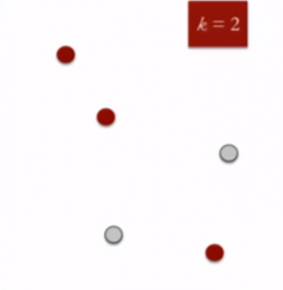
K Means Clustering
Specify the desired number of clusters K : Let us choose k=2 for these 5 data points in 2-D space.

Slide 8

K Means Clustering
Randomly assign each data point to a cluster : Let’s assign three points in cluster 1 shown using red color and two points in cluster 2 shown using grey color.

Slide 9
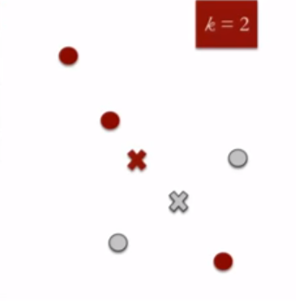
K Means Clustering
Compute cluster centroids : The centroid of data points in the red cluster is shown using red cross and those in grey cluster using grey cross.

Slide 10
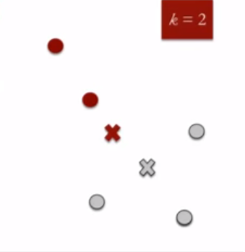
K Means Clustering
Re-assign each point to the closest cluster centroid : Note that only the data point at the bottom is assigned to the red cluster even though its closer to the centroid of grey cluster. Thus, we assign that data point into grey cluster

Slide 11
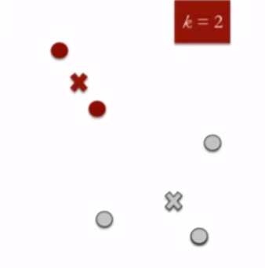
K Means
Re-compute cluster centroids : Now, re-computing the centroids for both the clusters.

Slide 12
K Means
Repeat steps 4 and 5 until no improvements are possible : Similarly, we’ll repeat the 4th and 5th steps until we’ll reach global optima. When there will be no further switching of data points between two clusters for two successive repeats. It will mark the termination of the algorithm if not explicitly mentioned.

Slide 13
K-means Clustering Algorithm
2 steps
1. Data assigment step:
Each centroid defines one of the clusters. In this step, each data point is assigned to its nearest centroid, based on the squared Euclidean distance.

Slide 14

More formally, if c_{i} is the collection of centroids in set C, then each data point x is assigned to a cluster based on
where dist( · ) is the standard (L₂) Euclidean distance. Let the set of data point assignments for each i^{th} cluster centroid be S_{i}.

Slide 15

2. Centroid update step:
In this step, the centroids are recomputed. This is done by taking the mean of all data points assigned to that centroid's cluster.
The algorithm iterates between steps one and two until a stopping criteria is met (i.e., no data points change clusters, the sum of the distances is minimized, or some maximum number of iterations is reached).

Slide 16
This algorithm is guaranteed to converge to a result. The result may be a local optimum (i.e. not necessarily the best possible outcome), meaning that assessing more than one run of the algorithm with randomized starting centroids may give a better outcome.

Slide 17
K-Means Clustering:
K-Means clustering algorithm works as below:
Choose the number of clusters k
Select random k points known as centroids
Assign each data-point to closest centroid
Compute and place new centroid of each cluster
Reassign each data point to new closest centroid. If any reassignment took place again compute and place new centriod else finish
As we are going to use Python libraries we need to provide only data-set and Elbow method will identify the right number of clusters.

Slide 18
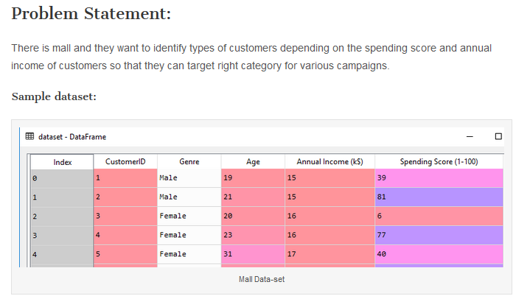

Slide 19
Choosing right number of clusters:
To identify the number of clusters we will use ‘Elbow Method‘ of K-means clustering algorithm.Following is the code snippet.

Slide 20
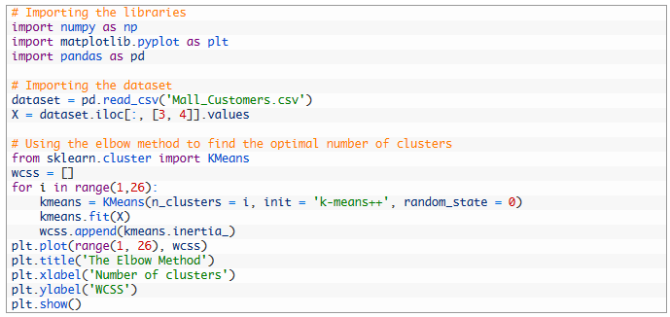

Slide 21
In above code,
KMeans is class of sklearn.cluster library
wcss (Within Clusters Sum of Squares ) is an array where we store kmeans.inertia_ is Sum of squared distances of samples to their closest cluster center.
Then we created a for loop to iterate from 1 to 25 and for each iteration, invoked KMeans algorithm with ‘k-means++’ method and random state as 0. We also appended kmeans.inertia_ to wcss array to keep record of all values for each Kmeans cluster from 1 to 25. This will be useful in plotting elbow graph.
After executing above code a graph will be plotted as below

Slide 22
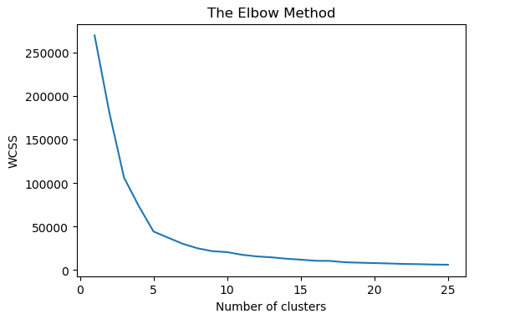
Notes:
In graph,we can see a curve which look like an elbow.The point where the curve is,it is the optimum number of clusters in our data-set i.e.5.

Slide 23
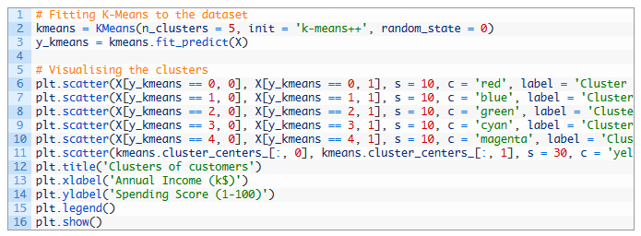
After choosing the right number of clusters we are ready to fit data-set into K-Means and visualize the types of customers in our data-set.To see the final results execute the following code snippet

Slide 24
Here,
from elbow method we have 5 clusters and same we have provided to KMeans algorithm
y_kmeans will have predicted types of customers in the form of clusters
Then we plotted types with different colors with actual customers
Execute above code and final result will look like below

Slide 25
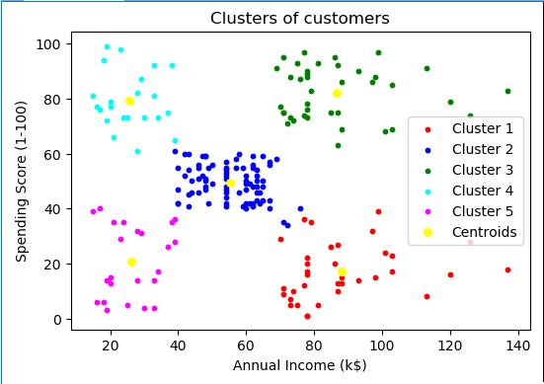

Slide 26
Observe the 5 clusters. They can be categorized into
red cluster: Customers with high annual income but less spending score
magenta cluster: Customers with low income and low spending score
blue cluster: Customers with moderate income and moderate spending score
cyan cluster: Customers with low income but high spending score
green cluster: Customers with high income and high spending score.
yellow points are centroids for each cluster.

